Slide 1
A Robust Transformer-Based Sentiment Analysis System
GUIDED BY,
Mr.N.Umakanth
AP(Sl.G.)
Muhesh Prabhu S, 23BCS047
Pugal Abishek A, 23BCS051

Slide 2
Introduction
Sentiment analysis is a fundamental task in Natural Language Processing (NLP) that focuses on identifying and classifying the textual data. With the rapid growth of social media platforms and from many sources Large volumes of data are generated making the sentiment analysis efficient. Due to noisy data, most Sentiment analysis models struggles across different datasets and fail to capture negation.

Slide 3
Problem Statement
Existing sentiment analysis models suffer from poor robustness, limited contextual understanding, Limited awareness of negation, and high sensitivity to noisy or real-world text data.
Also the previous models struggles for complex inputs and doesn’t build up the relationships between words continuously written.

Slide 4
To design a data encoding module that converts raw text into content and positional vectors and feed it to Transformer.
To construct a 12-layer transformer encoder with disentangled multi-head attention mechanism to capture long semantic relationships and provide Adversarial Training.
To develop a ON-LSTM layer to get Hierarchical representation of tokens.
To design an attention pooling module that takes important information from neuron and classifying the sentiment scores after Fully connected layer.
To integrate an optuna-based Bayesian hyper-parameter optimization modules to tune model parameters and improve overall performance
Objectives

Slide 5
Expected Outcomes
The raw text is successfully transformed into robust numerical embedding that are resistance to adversarial inputs.
Deep and long contextual relationships between words are effectively
captured with the help of Transformer Encoder.
Hierarchical representation of neurons are generated from low-level to high-level from which important information are taken with Attention weight.
Generates sentiment scores with help of FC and soft-max
Optimal hyper-parameter configurations are automatically identified through optuna’s Bayesian search, resulting in improved model accuracy and reduced manual tuning effort.

Slide 6
Literature Survey - 1
He et al., “DeBERTaV3: Improving DeBERTa Using ELECTRA-Style Pre-Training with Gradient-Disentangled Embedding Sharing,” ICLR 2023.
Replaces MLM with Replaced Token Detection (RTD).
Uses ELECTRA-style generator/discriminator pre-training.
Introduces Gradient-Disentangled Embedding Sharing (GDES).
Reduces the conflicting gradient effect between generator and discriminator embeddings.
Why because is that both the Generator and Discriminator will end up in tug of war situation.
He et al., “DeBERTaV3: Improving DeBERTa Using ELECTRA-Style Pre-Training with Gradient-Disentangled Embedding Sharing,” ICLR 2023.

Slide 7
Literature Survey – 1 contd
Merits:
More sample-efficient pre-training
Improves DeBERTa pre-training efficiency
Reduces embedding gradient conflict
Achieves strong downstream NLP performance
Demerits:
More complicated pre-training procedure
Requires generator and discriminator components
Increased implementation complexity
More computationally demanding than simple fine-tuning
He et al., “DeBERTaV3: Improving DeBERTa Using ELECTRA-Style Pre-Training with Gradient-Disentangled Embedding Sharing,” ICLR 2023.

Slide 8
Literature Survey - 2
Akiba et al. (2019), “Optuna: A Next-generation Hyperparameter Optimization Framework,” KDD 2019.
Provides an automated framework for hyperparameter optimization.
Uses efficient optimization and pruning strategies.
Automatically explores different hyperparameter configurations.
Can be integrated with machine-learning training workflows.
Efficient Search: Automatically explores different hyperparameter combinations to find better configurations.
Early Pruning: Stops poorly performing trials early, reducing unnecessary training time.
Akiba et al. (2019), “Optuna: A Next-generation Hyperparameter Optimization Framework,” KDD 2019.

Slide 9
Literature Survey – 2 contd
Merits:
Captures long-term dependencies
Reduces the vanishing-gradient problem
Effective for sequential data
Uses gated memory to control information flow
Demerits:
Sequential processing limits parallelization
Computationally more expensive than simple RNNs
Can still struggle with very long sequences
Does not explicitly model hierarchical structures
Akiba et al. (2019), “Optuna: A Next-generation Hyperparameter Optimization Framework,” KDD 2019.

Slide 10
Literature Survey - 3
Devlin et al. (2019) performed, "BERT: Pre-training of Deep
Bidirectional Transformers for Language Understanding," in Proc. NAACL-
HLT, Minneapolis, MN, USA, pp. 4171–4186, 2019.
BERT (Bidirectional Encoder Representations from Transformers):
Uses a bidirectional Transformer encoder to understand context from both left and right sides of a sentence.
Masked Language Model (MLM):
Randomly masks words and predicts them to learn contextual relationships.
Next Sentence Prediction (NSP):
Determines whether two sentences are logically connected.
Devlin et al., “BERT: Pre-training of Deep Bidirectional Transformers for Language Understanding,” 2019.

Slide 11
Literature Survey – 3 contd
Merits
Captures deep contextual meaning of words
Achieves high accuracy in sentiment analysis tasks
Supports transfer learning across NLP tasks
Handles complex sentence structures
Demerits
Requires high computational resources
Large model size
Slow training and inference
Needs large datasets
Devlin et al., “BERT: Pre-training of Deep Bidirectional Transformers for Language Understanding,” 2019.

Slide 12
Literature Survey - 4
He et al. (2021), “DeBERTa: Decoding-enhanced BERT with Disentangled Attention,” in ICLR 2021.
Disentangled Attention: Separately represents content information and position information.
Uses relative positional information to improve word-to-word interaction.
Enhanced Mask Decoder: Incorporates absolute position information during masked-token prediction.
Improves contextual and position-sensitive language representation.
He et al.: . Introduced DeBERTa, A Decoding-enhanced BERT model with Disentangled Attention. 2021

Slide 13
Literature Survey – 4 contd
Merits:
Better contextual representation than BERT
Separates content and positional information
Captures position-sensitive relationships
Strong performance on NLP tasks
Demerits:
High computational requirements
Large model size
Still primarily relies on Transformer-based contextual representation
Standard classification may not explicitly model hierarchical sequence structure
He et al.: . Introduced DeBERTa, A Decoding-enhanced BERT model with Disentangled Attention. 2021

Slide 14
Literature Survey - 5
Hochreiter and Schmidhuber, “Long Short-Term Memory,” Neural Computation, vol. 9, no. 8,pp 1997.
Adversarial Training: Adds small perturbations to input embeddings to improve robustness
FGM (Fast Gradient Method):
Applies single-step perturbation based on gradients
PGD (Projected Gradient Descent):
Multi-step adversarial attack for stronger robustness
Embedding Perturbation:
Forces model to learn stable representations under noisy inpu
Hochreiter and Schmidhuber, “Long Short-Term Memory,” Neural Computation, vol. 9, no. 8,pp 1997.

Slide 15
Literature Survey – 5 contd
Merits:
Handles long-term dependencies
Reduces vanishing-gradient problems
Effective for sequential data
Controls information using gated memory
Demerits:
Processes sequences sequentially
Limited parallelization
Mainly models linear sequential relationships
Does not explicitly impose hierarchical structure
Hochreiter and Schmidhuber, “Long Short-Term Memory,” Neural Computation, vol. 9, no. 8,pp 1997.

Slide 16
Literature Survey - 6
Shen et al. (2019), “Ordered Neurons: Integrating Tree Structures into Recurrent Neural Networks,” ICLR 2019.
Introduces Ordered Neurons LSTM (ON-LSTM).
Organizes neurons according to different information timescales.
Introduces master input and forget gates.
Uses the cumax() function to impose an ordering on neuron updates.
Enables the model to capture hierarchical/tree-like structures.
Shen et al. (2019), “Ordered Neurons: Integrating Tree Structures into Recurrent Neural Networks,” ICLR 2019.

Slide 17
Literature Survey – 6 contd
Merits:
Captures hierarchical structures
Preserves long-term information
Models different information timescales
Provides an inductive bias toward tree-like structures
Demerits:
More complex than standard LSTM
Adds additional parameters for master gates
Sequential processing remains a limitation
Primarily designed for recurrent sequence modeling
Shen et al. (2019), “Ordered Neurons: Integrating Tree Structures into Recurrent Neural Networks,” ICLR 2019.

Slide 18
Literature Survey - 7
Gupta and Joshi, “Feature-Based Twitter Sentiment Analysis With Improved Negation Handling,” IEEE Transactions on Computational Social Systems, 8(4) 2021.
Investigates the effect of negation on sentiment polarity.
Uses lexicon-based, morphological, POS-based and n-gram features.
Introduces negation exception rules for cases where a negation cue does not necessarily indicate actual negation.
Evaluates SVM, Naive Bayes and Decision Tree classifiers on SemEval-2013 Task 2
Gupta and Joshi, “Feature-Based Twitter Sentiment Analysis With Improved Negation Handling,” IEEE Transactions on Computational Social Systems, 8(4) 2021.

Slide 19
Literature Survey – 7 contd
Merits:
Explicitly models negation
Handles negation exception cases
Combines multiple linguistic features
Improves sentiment classification performance
Demerits:
Depends heavily on manually engineered features
Uses traditional machine-learning classifiers
Limited contextual representation compared with pretrained language models
Designed specifically for Twitter-style text
Gupta and Joshi, “Feature-Based Twitter Sentiment Analysis With Improved Negation Handling,” IEEE Transactions on Computational Social Systems, 8(4) 2021.

Slide 20
Literature Survey - 8
Goodfellow, Shlens and Szegedy, “Explaining and Harnessing Adversarial Examples,” ICLR 2015.
Sequence-to-Sequence (Seq2Seq) Model: Converts natural language input into structured outputs
Encoder–Decoder Architecture: Encodes input text and generates corresponding output
Attention Mechanism: Focuses on important words during generation
Text-to-Visualization Mapping: Translates user queries into visual representations
Goodfellow, Shlens and Szegedy, “Explaining and Harnessing Adversarial Examples,” ICLR 2015.

Slide 21
Literature Survey – 8 contd
Merits:
Simple and computationally efficient
Uses gradient information to create perturbations
Improves model robustness through adversarial training
Provides a foundation for gradient-based adversarial methods
Demerits:
Single-step perturbation may be weaker than iterative methods
Perturbation strength must be carefully selected
Originally demonstrated mainly in image/classification settings
Does not specifically address NLP embedding spaces
Goodfellow, Shlens and Szegedy, “Explaining and Harnessing Adversarial Examples,” ICLR 2015.

Slide 22
Literature Survey - 9
Zhu et al., “FreeLB: Enhanced Adversarial Training for Natural Language Understanding,” ICLR 2020.
Applies adversarial perturbations directly to word embeddings.
Uses multiple perturbation steps to improve robustness.
Encourages greater invariance in the embedding space.
Demonstrates improvements on Transformer-based NLP models.
It is also know as Free-Latch Batches instead of computing and updating
computes single time and updates
Zhu et al. (2020), “FreeLB: Enhanced Adversarial Training for Natural Language Understanding,” ICLR 2020.

Slide 23
Literature Survey – 9 contd
Merits:
Designed specifically for NLP
Perturbs word embeddings
Improves robustness and generalization
Works effectively with Transformer models
Demerits:
Requires additional adversarial computation
Multiple perturbation steps increase training time
Requires careful selection of perturbation parameters
More expensive than normal fine-tuning
Zhu et al. (2020), “FreeLB: Enhanced Adversarial Training for Natural Language Understanding,” ICLR 2020.

Slide 24
Literature Survey - 10
Liu et al., “OnDeBERTa: An Ordered Neuron Memory Enhanced DeBERTa Model for E-commerce Review Sentiment Classification,” CICSE 2026.
Combines DeBERTa + ON-LSTM + Attention Pooling.
Uses DeBERTa for contextual representation.
Uses ON-LSTM to model hierarchical sequence information.
Uses attention pooling to emphasize important sentiment fragments.
Evaluated on the Amazon Review Polarity dataset.
Liu et al. (2026), “OnDeBERTa: An Ordered Neuron Memory Enhanced DeBERTa Model for E-commerce Review Sentiment Classification,” CICSE 2026.

Slide 25
Literature Survey – 10 contd
Merits:
Combines contextual and hierarchical representation
Better handling of negation, contrast and delayed sentiment cues
Attention pooling focuses on important sentiment fragments
Achieves 94.18% accuracy and 91.64% F1-score in the reported one-layer configuration.
Demerits:
Increased architectural complexity
Higher computational cost than plain DeBERTa
Requires an additional ON-LSTM decoder
Performance depends on pooling and decoder configuration
Liu et al. (2026), “OnDeBERTa: An Ordered Neuron Memory Enhanced DeBERTa Model for E-commerce Review Sentiment Classification,” CICSE 2026.

Slide 26
Literature Survey – 1 - 3
Consolidation of the literatures:
# | Author(s) & Year | Methodology used | Limitations
1 | Elman (1990) | Proposed a simple recurrent neural network using recurrent connections to maintain previous Information. | Difficulty in learning long-term dependencies; vanishing
2 | Hochreiter & Schmidhuber (1997) | Introduced LSTM with gated memory and cell state to capture long-term dependencies in sequential data. | Sequential computation; higher complexity than basic RNN; limited parallelization.
3 | Shen et al. (2019) | Proposed ON-LSTM with ordered neurons, master gates and cumax to model hierarchical sequences. | More complex than LSTM; recurrent computation; additional parameters.
4 | Devlin et al. (2019) | Proposed BERT using a bidirectional Transformer encoder with pre-training through MLM and NSP. | Large computational and memory requirements; expensive pre-training.

Slide 27
Literature Survey – 4 - 6
Consolidation of the literatures:
# | Author(s) & Year | Methodology used | Limitations
5 | He et al. (2021) | Proposed DeBERTa with disentangled attention to separately model content and relative positional information. | High computational cost; large model size; does not explicitly model hierarchical structure.
6 | Gupta & Joshi (2021) | Proposed feature-based sentiment analysis - negation handling using linguistic features and negation rules. | Requires manual feature engineering; limited contextual understanding.
7 | Goodfellow et al. (2015) | Introduced gradient-based adversarial and adversarial training to improve neural network robustness. | Single-step perturbation can be weaker than iterative methods; requires tuning.
8 | Zhu et al. (2020) | Proposed FreeLB, which performs multi-step adversarial perturbation. | Requires adversarial hyperparameter tuning.

Slide 28
Literature Survey – 7 - 9
Consolidation of the literatures:
# | Author(s) & Year | Methodology used | Limitations
9 | Liu et al. (2026) | Proposed combining DeBERTa, ON-LSTM, attention pooling hierarchical sentiment representation. | Increased model complexity and cost due to additional ON-LSTM decoder.
10 | Akiba et al. (2019) | Proposed Optuna for automated hyperparameter optimization using trial-based search and early pruning. | Multiple trials require considerable computational resources.

Slide 29
Dataset Details
DATASET NAME | IMDB MOVIE REVIEWS
No of Records | 50,000
No of Classes | 2
Name of Classes | Positive / Negative
Split Representation (%) | 70 / 20 / 10
No of Records for Training | 35,000 (70%)
No of Records for Testing | 10,000 (20%)
No of Records for Validation | 5,000(10%)

Slide 30
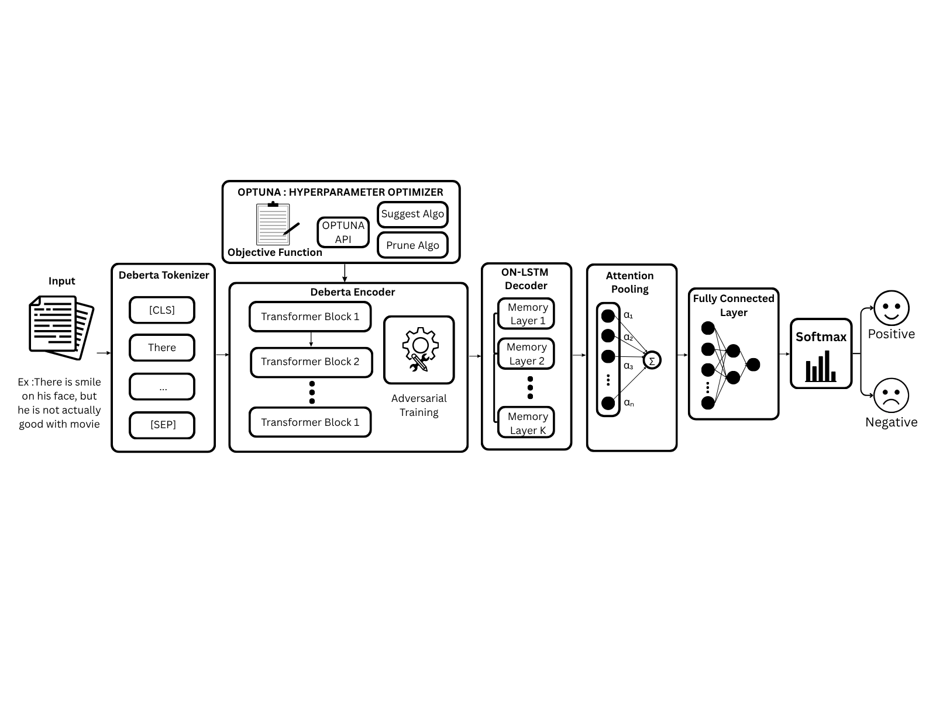
SYSTEM DIAGRAM

Slide 31
Description of Modules
1. Data Preprocessing and Tokenization:
Data Preprocessing in the sense cleaning, standardizing, and removing structural noises
DeBERT Tokenizer is used to convert raw text into token IDs that the model can process.
Process:
Text cleaning: White space removal, lowercasing, word normalization, structural noise filtering.
Tensor Generation: Generates input_ids, attention_mask tensors.
Sequence Formatting: Standardizes input length to a maximum of 256 tokens using padding and truncation.

Slide 32
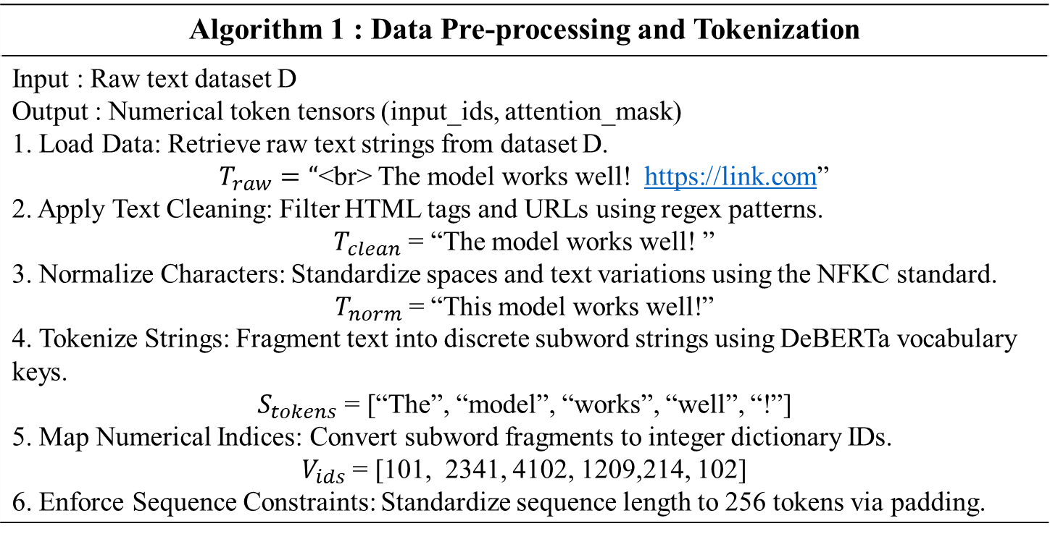
Description of Modules
Algorithm 1 : Data Pre-processing and Tokenization
Input : Raw text dataset D Output : Numerical token tensors (input_ids, attention_mask) 1. Load Data: Retrieve raw text strings from dataset D. $T_{raw}=“$<br> The model works well! https://link.com” 2. Apply Text Cleaning: Filter HTML tags and URLs using regex patterns. $T_{clean}$ = “The model works well! ” 3. Normalize Characters: Standardize spaces and text variations using the NFKC standard. $T_{norm}$= “This model works well!” 4. Tokenize Strings: Fragment text into discrete subword strings using DeBERTa vocabulary keys. $S_{tokens}$ = [“The”, “model”, “works”, “well”, “!”] 5. Map Numerical Indices: Convert subword fragments to integer dictionary IDs. $V_{ids}$ = [101, 2341, 4102, 1209,214, 102] 6. Enforce Sequence Constraints: Standardize sequence length to 256 tokens via padding.

Slide 33
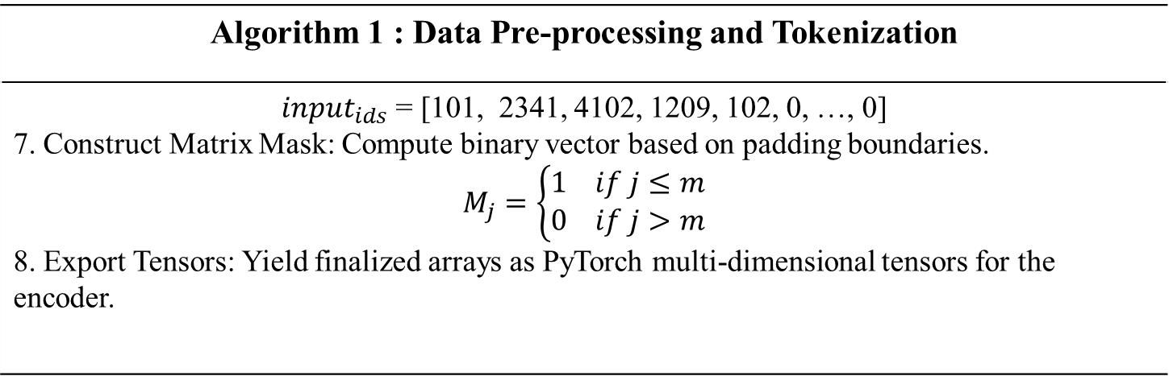
Description of Modules
Algorithm 1 : Data Pre-processing and Tokenization
${input}_{ids}$ = [101, 2341, 4102, 1209, 102, 0, …, 0] 7. Construct Matrix Mask: Compute binary vector based on padding boundaries. $$M_{j}=\left\{\begin{aligned}1 if j≤m \\ 0 if j>m\end{aligned}\right.$$ 8. Export Tensors: Yield finalized arrays as PyTorch multi-dimensional tensors for the encoder.

Slide 34
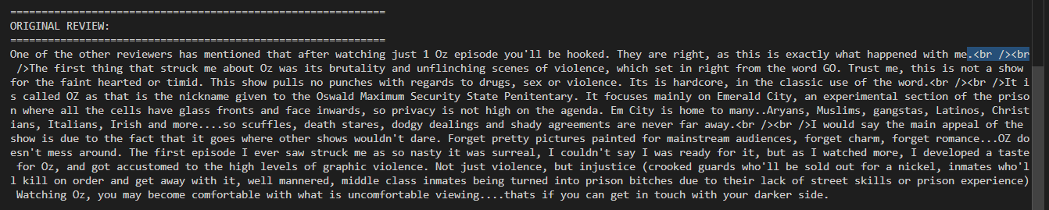
Description of Modules
Results : Preprocessing
Input : The Movie is so Good <br > it is so full of twists !!!!
Output : The Movie is so Good it is so full of twists

Slide 35
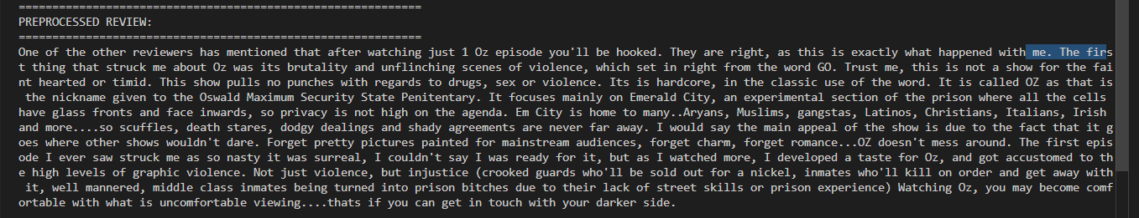
Description of Modules
Results : Preprocessing

Slide 36
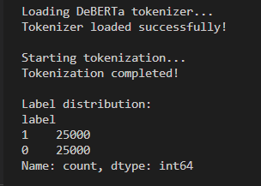
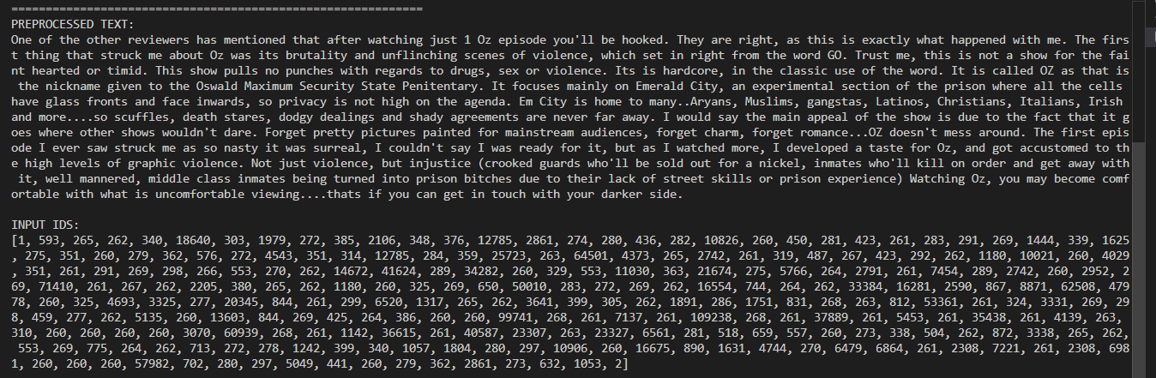
Description of Modules
Results : Tokenization
Lable representation and Input_ids

Slide 37
Description of Modules
2. Deberta Encoder:
Coverts discrete token IDs into continuous vector representations.
Content Embedding: Represents semantic representation of each token.
Position Embedding: Represents positional representation of each token.
Disentangled Representation: Both content and positional representation are passed to Deberta Transformer Layers .
Residual Connection: The original input is added to attention output to prevent data loss.
Layer Normalization: The values are scaled uniformly to stabilize training
Feed-Forward Network (FFN): The vectors pass through a two-layer linear network with a non-linear activation function (GELU).
Also after Deberta encoder the Vector is then passed to the ON-LSTM Decoder.

Slide 38
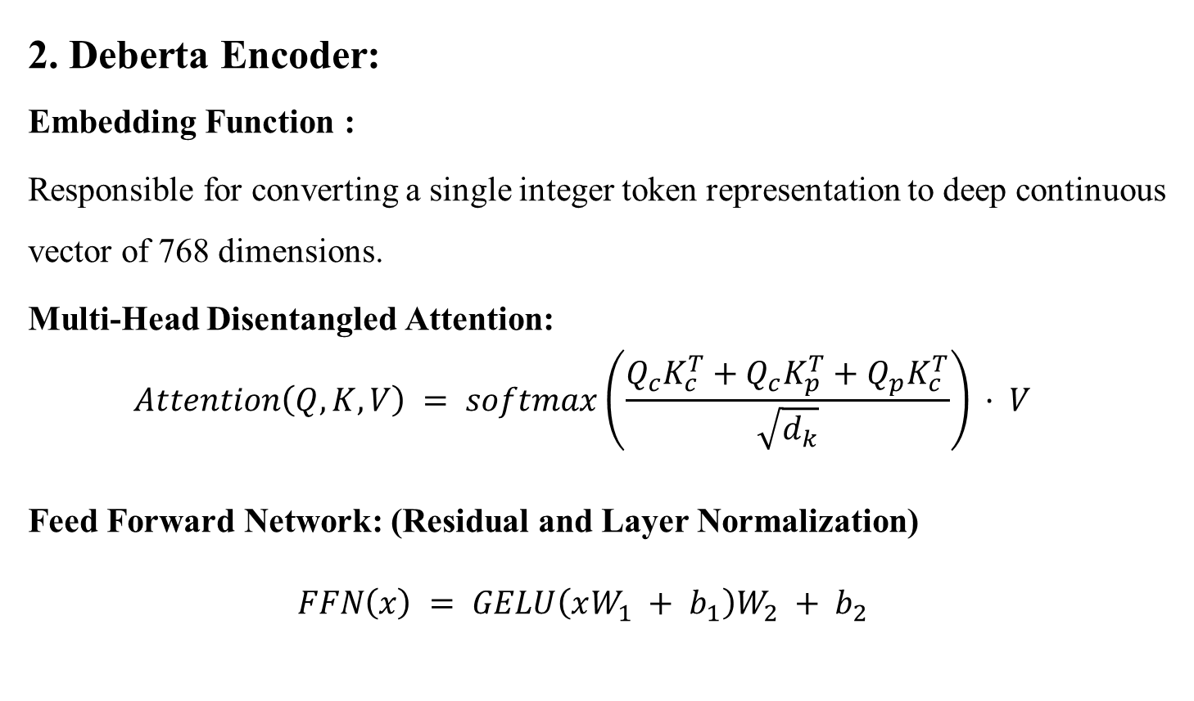
Description of Modules
2. Deberta Encoder:
Embedding Function :
Responsible for converting a single integer token representation to deep continuous vector of 768 dimensions.
Multi-Head Disentangled Attention:
$$Attention\left(Q, K, V\right) = softmax\left(\frac{Q_{c}K_{c}^{T}+Q_{c}K_{p}^{T}+Q_{p}K_{c}^{T}}{\sqrt{d_{k}}}\right) · V$$
Feed Forward Network: (Residual and Layer Normalization)
$$FFN\left(x\right) = GELU\left(xW_{1} + b_{1}\right)W_{2} + b_{2}$$

Slide 39
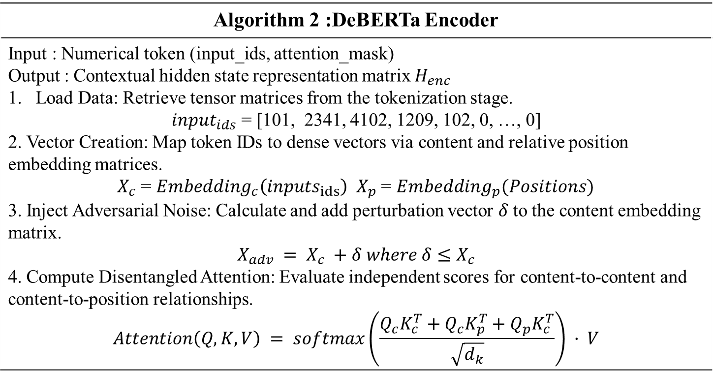
Description of Modules
Algorithm 2 :DeBERTa Encoder
Input : Numerical token (input_ids, attention_mask) Output : Contextual hidden state representation matrix $H_{enc}$ Load Data: Retrieve tensor matrices from the tokenization stage. ${input}_{ids}$ = [101, 2341, 4102, 1209, 102, 0, …, 0] 2. Vector Creation: Map token IDs to dense vectors via content and relative position embedding matrices. $X_{c}$ = $Embedding_{c}\left(inputs_{ids}\right)$ $X_{p}$= $Embedding_{p}(Positions)$ 3. Inject Adversarial Noise: Calculate and add perturbation vector $δ$to the content embedding matrix. $$X_{adv} = X_{c} +δ where δ≤X_{c}$$ 4. Compute Disentangled Attention: Evaluate independent scores for content-to-content and content-to-position relationships. $$Attention\left(Q, K, V\right) = softmax\left(\frac{Q_{c}K_{c}^{T}+Q_{c}K_{p}^{T}+Q_{p}K_{c}^{T}}{\sqrt{d_{k}}}\right) · V$$

Slide 40
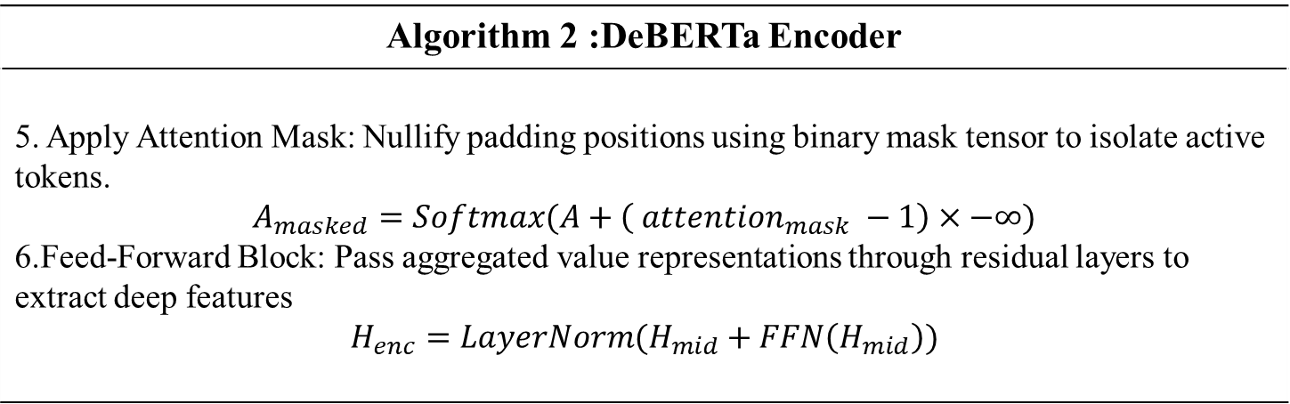
Description of Modules
Algorithm 2 :DeBERTa Encoder
5. Apply Attention Mask: Nullify padding positions using binary mask tensor to isolate active tokens. $$A_{masked}=Softmax(A+\left( attention_{mask} −1\right)×−∞)$$ 6.Feed-Forward Block: Pass aggregated value representations through residual layers to extract deep features $$H_{enc}=LayerNorm(H_{mid}+FFN\left(H_{mid}\right))$$

Slide 41
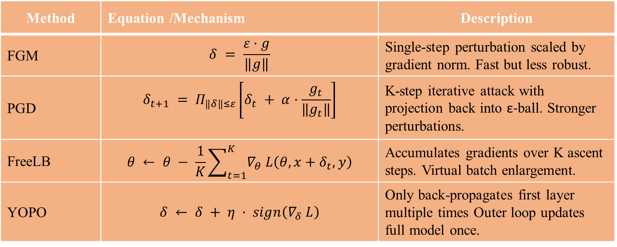
Description of Modules
3. Adversarial Training Module:
Adversarial perturbations are injected into the embedding layer during training to improve model robustness. Four methods are
Method | Equation /Mechanism | Description
FGM | $$δ = \frac{ε·g}{‖g‖}$$ | Single-step perturbation scaled by gradient norm. Fast but less robust.
PGD | $$δ_{t+1} = Π_{‖δ‖≤ε}\left[δ_{t} + α·\frac{g_{t}}{‖g_{t}‖}\right]$$ | K-step iterative attack with projection back into ε-ball. Stronger perturbations.
FreeLB | $$θ ← θ − \frac{1}{K}\sum_{t=1}^{K}{∇_{θ} L\left(θ, x+δ_{t}, y\right)}$$ | Accumulates gradients over K ascent steps. Virtual batch enlargement.
YOPO | $$δ ← δ + η · sign\left(∇_{δ} L\right)$$ | Only back-propagates first layer multiple times Outer loop updates full model once.

Slide 42
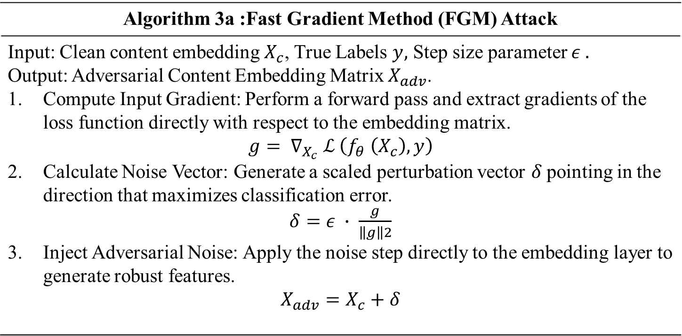
Description of Modules
Algorithm 3a :Fast Gradient Method (FGM) Attack
Input: Clean content embedding $X_{c}$, True Labels $y,$ Step size parameter $ε .$ Output: Adversarial Content Embedding Matrix $X_{adv}$. Compute Input Gradient: Perform a forward pass and extract gradients of the loss function directly with respect to the embedding matrix. $$g= ∇_{X_{c}} ℒ \left(f_{θ} \left(X_{c}\right), y\right)$$ Calculate Noise Vector: Generate a scaled perturbation vector $δ$pointing in the direction that maximizes classification error. $δ=ε ∙$ $\frac{g}{\left\|g\right\|2}$ Inject Adversarial Noise: Apply the noise step directly to the embedding layer to generate robust features. $$X_{adv}=X_{c}+δ$$

Slide 43
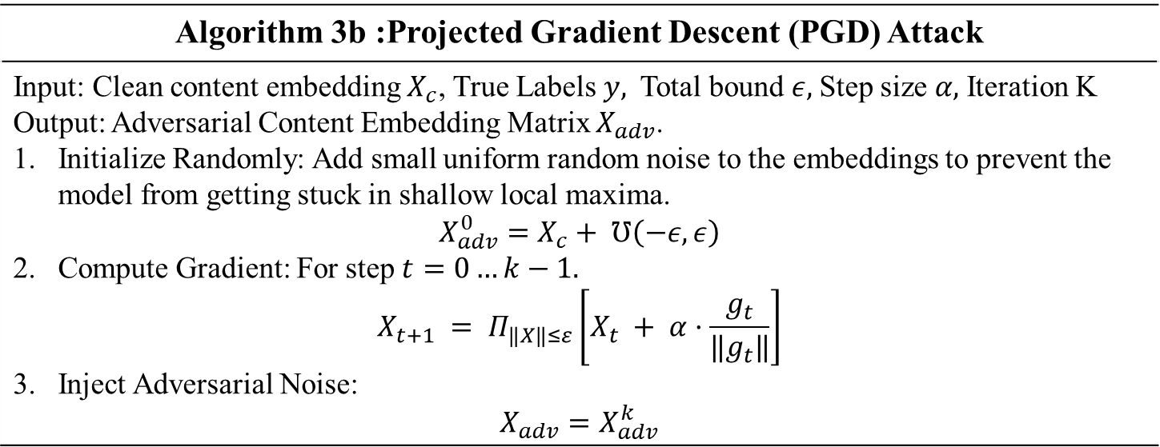
Description of Modules
Algorithm 3b :Projected Gradient Descent (PGD) Attack
Input: Clean content embedding $X_{c}$, True Labels $y,$Total bound $ε,$Step size $α,$Iteration K Output: Adversarial Content Embedding Matrix $X_{adv}$. Initialize Randomly: Add small uniform random noise to the embeddings to prevent the model from getting stuck in shallow local maxima. $$X_{adv}^{0}=X_{c}+ ℧\left(−ε, ε\right)$$ Compute Gradient: For step $t=0…k−1.$ $$X_{t+1} = Π_{‖X‖≤ε}\left[X_{t} + α·\frac{g_{t}}{‖g_{t}‖}\right]$$ Inject Adversarial Noise: $$X_{adv}=X_{adv}^{k}$$

Slide 44
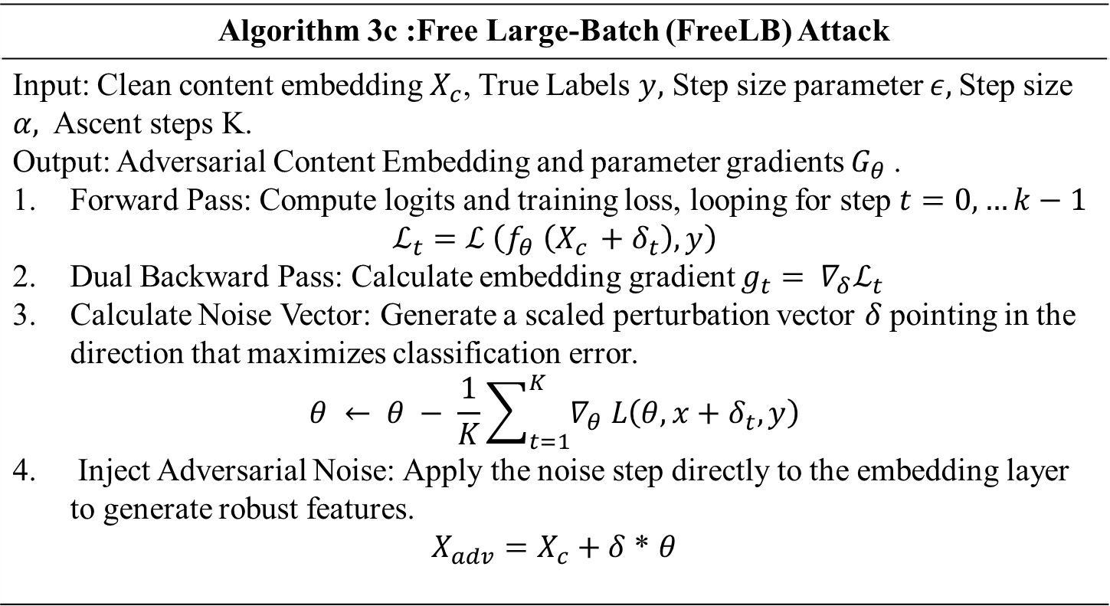
Description of Modules
Algorithm 3c :Free Large-Batch (FreeLB) Attack
Input: Clean content embedding $X_{c}$, True Labels $y,$ Step size parameter $ε,$Step size $α,$Ascent steps K. Output: Adversarial Content Embedding and parameter gradients $G_{θ}$. Forward Pass: Compute logits and training loss, looping for step $t=0,…k−1$ $$ℒ_{t}=ℒ \left(f_{θ} \left(X_{c }+δ_{t}\right), y\right)$$ Dual Backward Pass: Calculate embedding gradient $g_{t}= ∇_{δ}ℒ_{t}$ Calculate Noise Vector: Generate a scaled perturbation vector $δ$pointing in the direction that maximizes classification error. $$θ ← θ − \frac{1}{K}\sum_{t=1}^{K}{∇_{θ} L\left(θ, x+δ_{t}, y\right)}$$ Inject Adversarial Noise: Apply the noise step directly to the embedding layer to generate robust features. $X_{adv}=X_{c}+δ$ * $θ$

Slide 45
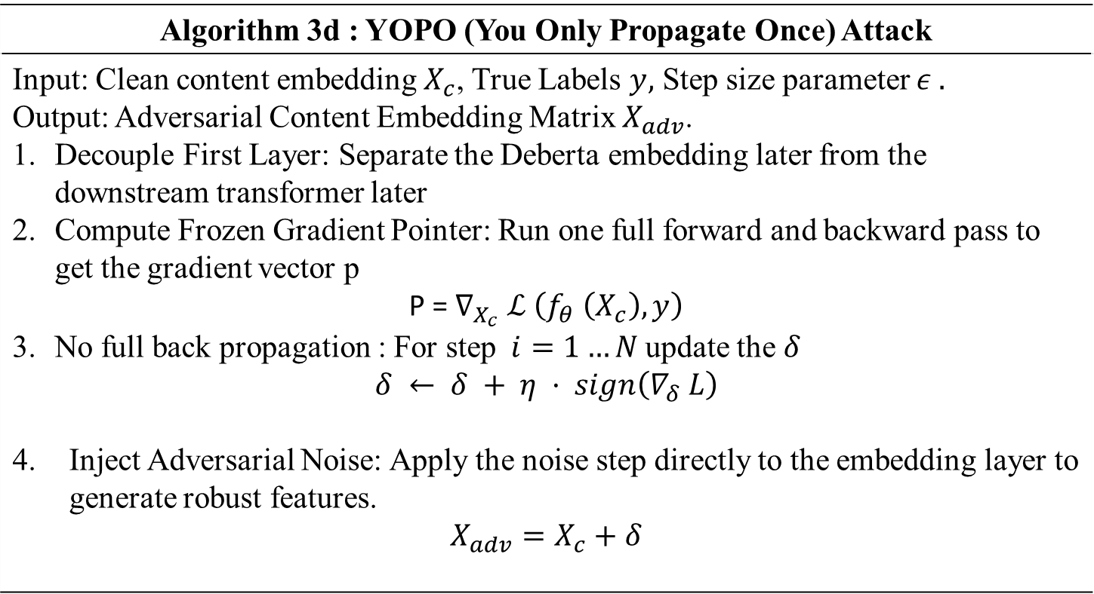
Description of Modules
Algorithm 3d : YOPO (You Only Propagate Once) Attack
Input: Clean content embedding $X_{c}$, True Labels $y,$ Step size parameter $ε .$ Output: Adversarial Content Embedding Matrix $X_{adv}$. Decouple First Layer: Separate the Deberta embedding later from the downstream transformer later Compute Frozen Gradient Pointer: Run one full forward and backward pass to get the gradient vector p P =$∇_{X_{c}} ℒ \left(f_{θ} \left(X_{c}\right), y\right)$ No full back propagation : For step $i=1…N$update the $δ$ $$δ ← δ + η · sign\left(∇_{δ} L\right)$$ Inject Adversarial Noise: Apply the noise step directly to the embedding layer to generate robust features. $$X_{adv}=X_{c}+δ$$

Slide 46
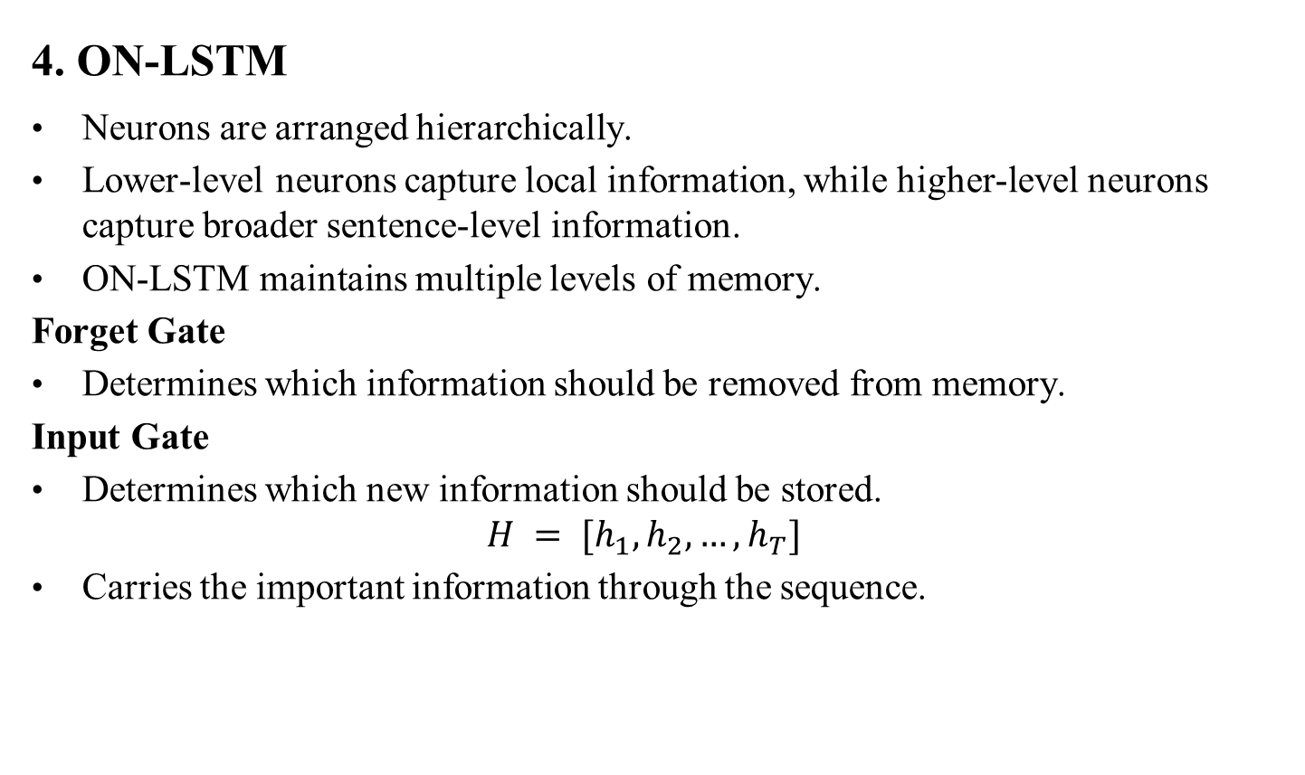
Description of Modules
4. ON-LSTM
Neurons are arranged hierarchically.
Lower-level neurons capture local information, while higher-level neurons capture broader sentence-level information.
ON-LSTM maintains multiple levels of memory.
Forget Gate
Determines which information should be removed from memory.
Input Gate
Determines which new information should be stored.
$H = [h_{1}, h_{2}, …, h_{T}]$
Carries the important information through the sequence.

Slide 47
Description of Modules
4. ON-LSTM
Master Forget Gate
Controls memory updates hierarchically.
Allows groups of neurons to be forgotten together.
Master Input
Gate Controls how new information enters the hierarchical memory. Used to create the ordered/master gates.
Produces a hierarchical ordering of neurons.
Cumax Function
Cumax function finds the ultimate cumulation addition of a particular vector passed to it

Slide 48
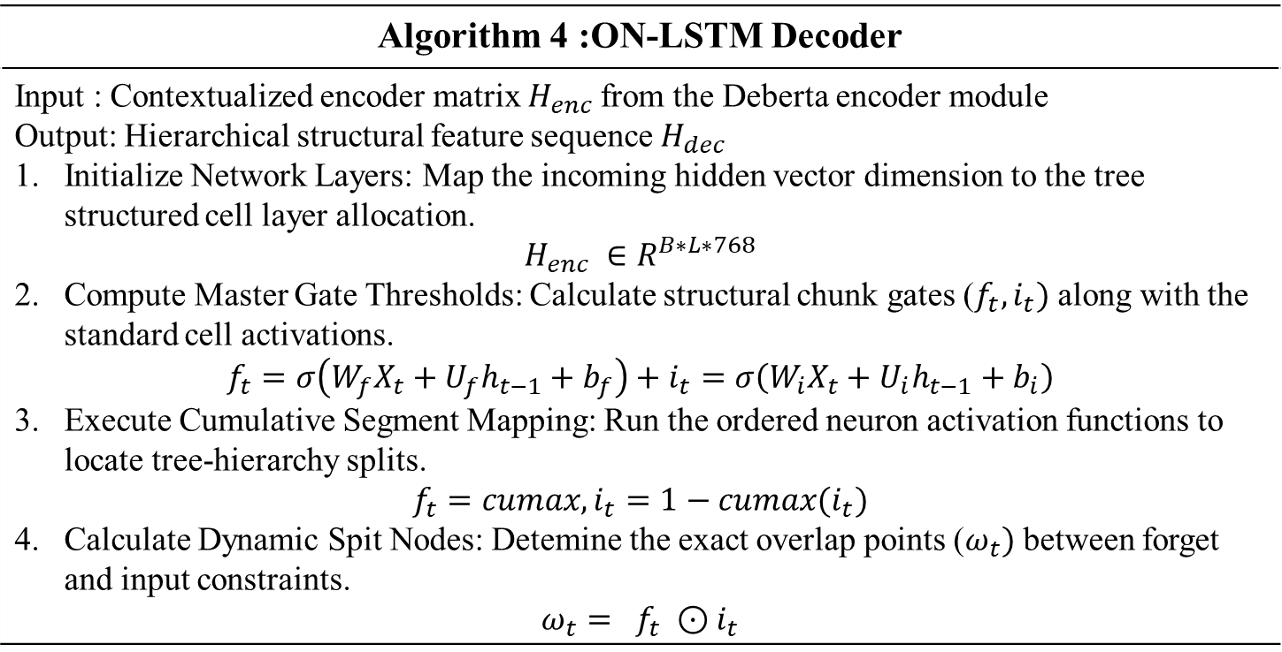
Description of Modules
Algorithm 4 :ON-LSTM Decoder
Input : Contextualized encoder matrix $H_{enc}$from the Deberta encoder module Output: Hierarchical structural feature sequence $H_{dec}$ Initialize Network Layers: Map the incoming hidden vector dimension to the tree structured cell layer allocation. $$H_{enc} ∈R^{B∗L∗768}$$ Compute Master Gate Thresholds: Calculate structural chunk gates ($f_{t},i_{t})$ along with the standard cell activations. $$f_{t}=σ\left(W_{f}X_{t}+U_{f}h_{t−1}+b_{f}\right)+i_{t}=σ\left(W_{i}X_{t}+U_{i}h_{t−1}+b_{i}\right)$$ Execute Cumulative Segment Mapping: Run the ordered neuron activation functions to locate tree-hierarchy splits. $$f_{t}=cumax, i_{t}=1−cumax(i_{t})$$ Calculate Dynamic Spit Nodes: Detemine the exact overlap points ($ω_{t})$ between forget and input constraints. $$ω_{t}= f_{t} ⊙i_{t}$$

Slide 49
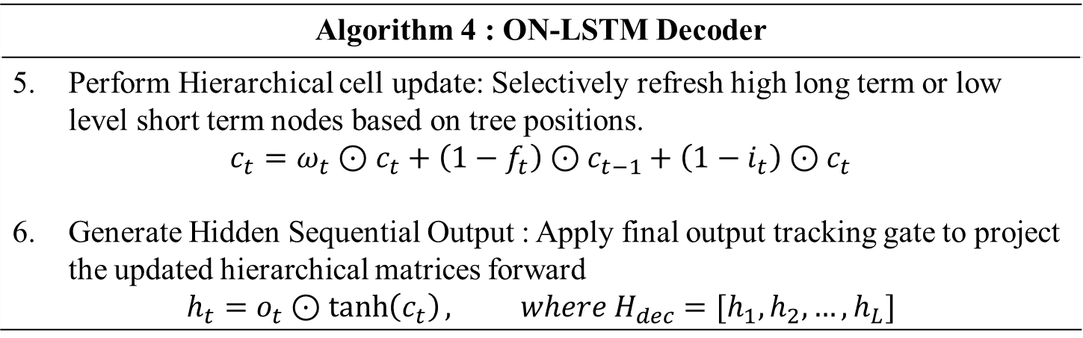
Description of Modules
Algorithm 4 : ON-LSTM Decoder
Perform Hierarchical cell update: Selectively refresh high long term or low level short term nodes based on tree positions. $$c_{t}=ω_{t}⊙c_{t}+\left(1−f_{t}\right)⊙c_{t−1}+\left(1−i_{t}\right)⊙c_{t}$$ Generate Hidden Sequential Output : Apply final output tracking gate to project the updated hierarchical matrices forward $$h_{t}=o_{t}⊙\tanh\left(c_{t}\right), where H_{dec}=[h_{1},h_{2},…, h_{L}]$$

Slide 50
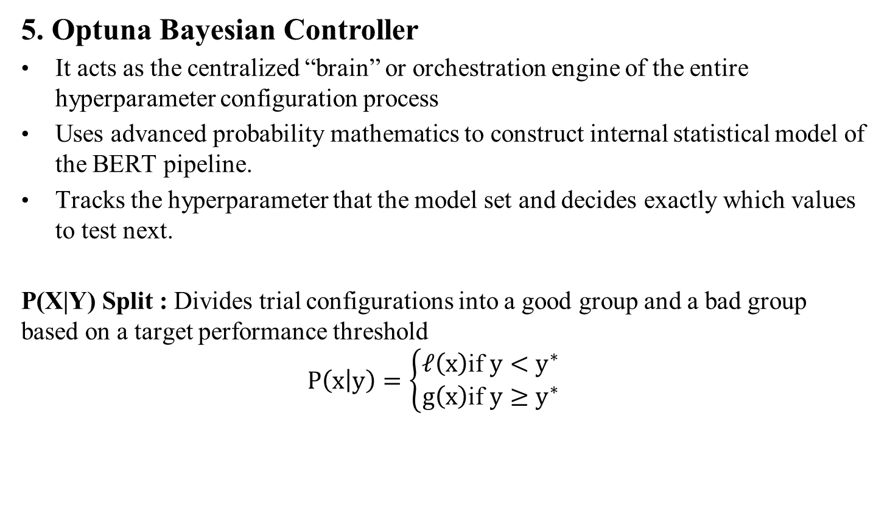
Description of Modules
5. Optuna Bayesian Controller
It acts as the centralized “brain” or orchestration engine of the entire hyperparameter configuration process
Uses advanced probability mathematics to construct internal statistical model of the BERT pipeline.
Tracks the hyperparameter that the model set and decides exactly which values to test next.
P(X|Y) Split : Divides trial configurations into a good group and a bad group based on a target performance threshold
$$P\left(x | y\right)=\left\{\begin{aligned}𝓁\left(x\right)&\text{if} y<y^{∗} \\ g\left(x\right)&\text{if} y≥y^{∗}\end{aligned}\right.$$

Slide 51
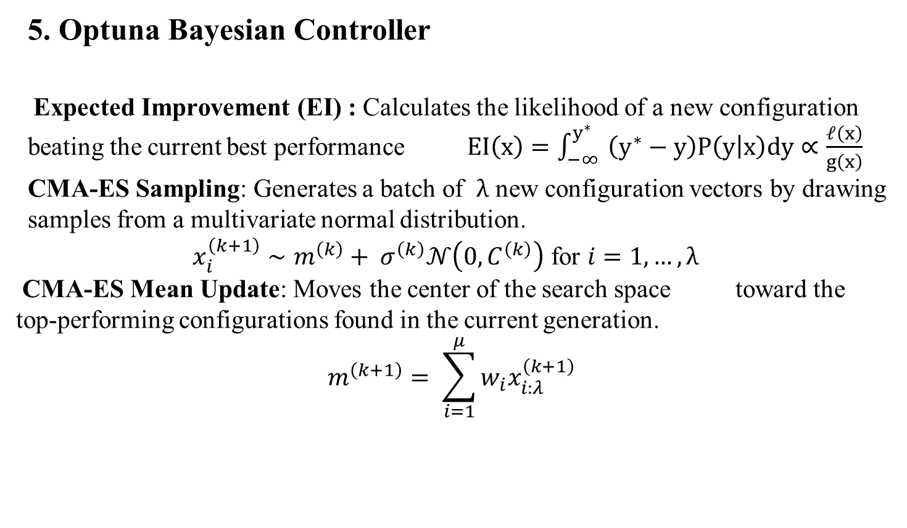
Description of Modules
5. Optuna Bayesian Controller
Expected Improvement (EI) : Calculates the likelihood of a new configuration beating the current best performance$EI\left(x\right)=\int_{−∞}^{y^{∗}}{ \left(y^{∗}−y\right)P\left(y | x\right)dy∝\frac{𝓁\left(x\right)}{g\left(x\right)}}$
CMA-ES Sampling: Generates a batch of $λ$ new configuration vectors by drawing samples from a multivariate normal distribution.
$$x_{i}^{\left(k+1\right)}∼m^{\left(k\right)}+ σ^{\left(k\right)}𝒩\left(0,C^{\left(k\right)}\right) \text{for} i=1,…,λ$$
CMA-ES Mean Update: Moves the center of the search space toward the top-performing configurations found in the current generation.
$$m^{\left(k+1\right)}= \sum_{i=1}^{μ}{w_{i}x_{i:λ}^{\left(k+1\right)}}$$

Slide 52
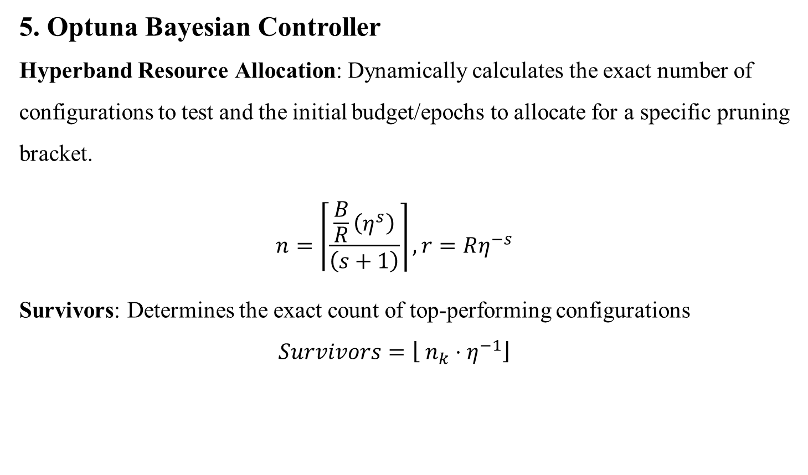
Description of Modules
5. Optuna Bayesian Controller
Hyperband Resource Allocation: Dynamically calculates the exact number of configurations to test and the initial budget/epochs to allocate for a specific pruning bracket.
$$n=\left\lceil \frac{\frac{B}{R}\left(η^{s}\right)}{\left(s+1\right)}\right\rceil , r=Rη^{−s}$$
Survivors: Determines the exact count of top-performing configurations
$$Survivors=\left\lfloor n_{k}⋅η^{−1}\right\rfloor$$

Slide 53
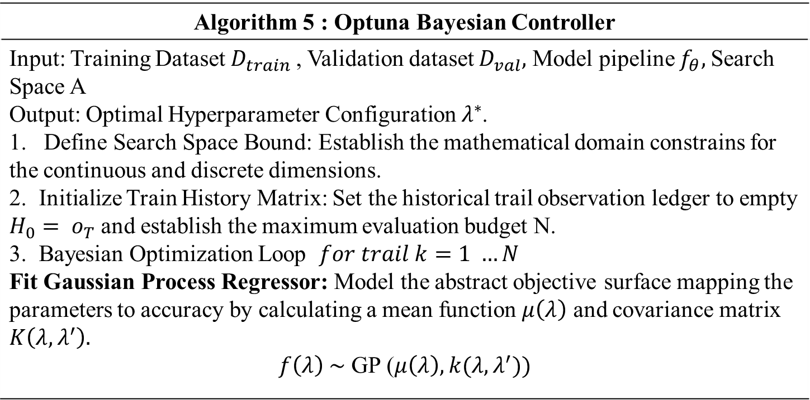
Description of Modules
Algorithm 5 : Optuna Bayesian Controller
Input: Training Dataset $D_{train}$, Validation dataset $D_{val},$ Model pipeline $f_{θ},$Search Space A Output: Optimal Hyperparameter Configuration $λ^{∗}$. 1. Define Search Space Bound: Establish the mathematical domain constrains for the continuous and discrete dimensions. 2. Initialize Train History Matrix: Set the historical trail observation ledger to empty $H_{0}= ο_{T}$ and establish the maximum evaluation budget N. 3. Bayesian Optimization Loop $for trail k=1 …N$ Fit Gaussian Process Regressor: Model the abstract objective surface mapping the parameters to accuracy by calculating a mean function $μ\left(λ\right)$ and covariance matrix $K\left(λ,λ^{′}\right).$ $f\left(λ\right) \sim$ GP ($μ\left(λ\right),k(λ,λ^{′}))$

Slide 54
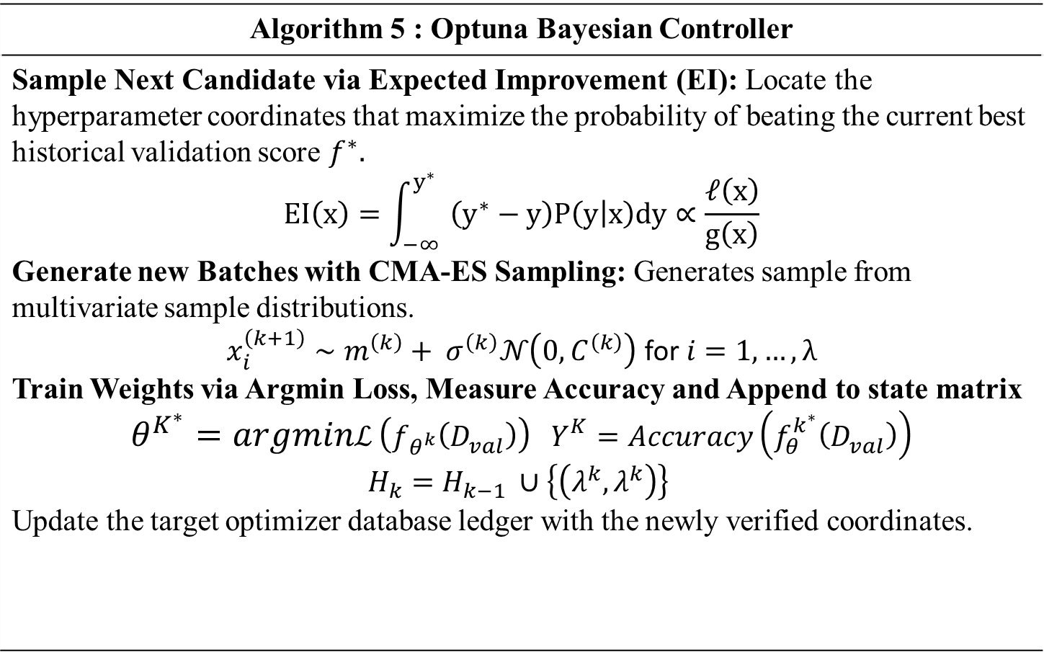
Description of Modules
Algorithm 5 : Optuna Bayesian Controller
Sample Next Candidate via Expected Improvement (EI): Locate the hyperparameter coordinates that maximize the probability of beating the current best historical validation score $f^{∗}.$ $$EI\left(x\right)=\int_{−∞}^{y^{∗}}{ \left(y^{∗}−y\right)P\left(y | x\right)dy∝\frac{𝓁\left(x\right)}{g\left(x\right)}}$$ Generate new Batches with CMA-ES Sampling: Generates sample from multivariate sample distributions. $$x_{i}^{\left(k+1\right)}∼m^{\left(k\right)}+ σ^{\left(k\right)}𝒩\left(0,C^{\left(k\right)}\right) \text{for} i=1,…,λ$$ Train Weights via Argmin Loss, Measure Accuracy and Append to state matrix $$θ^{K^{∗}}=argminℒ \left(f_{θ^{k}}\left(D_{val}\right)\right) Y^{K}=Accuracy\left(f_{θ}^{k^{∗}}\left(D_{val}\right)\right) \\ H_{k}=H_{k−1} ∪\left\{\left(λ^{k},λ^{k}\right)\right\}$$ Update the target optimizer database ledger with the newly verified coordinates.

Slide 55
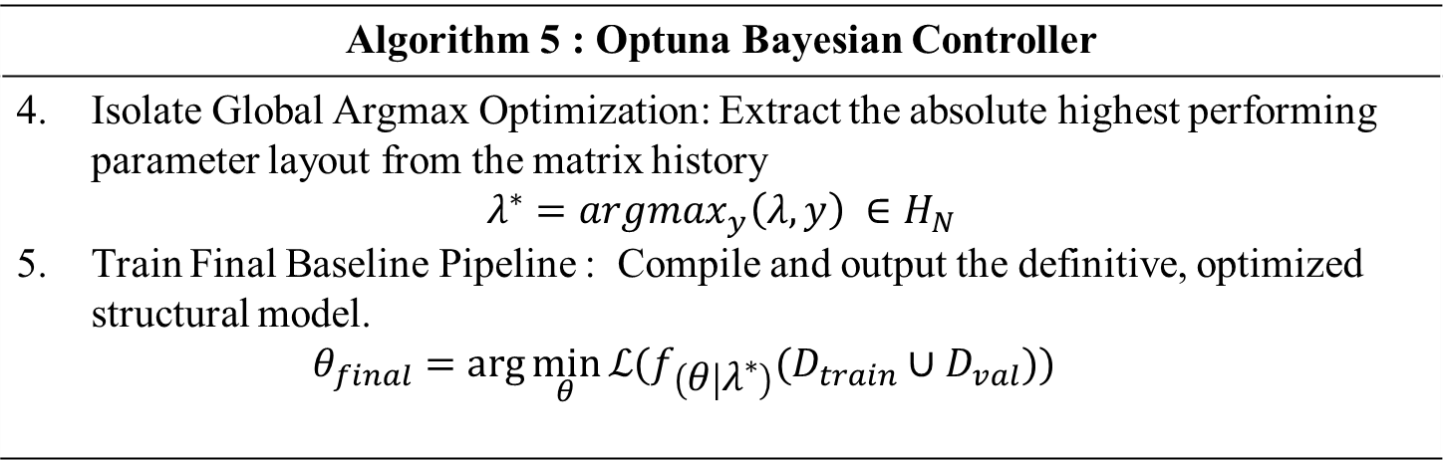
Description of Modules
Algorithm 5 : Optuna Bayesian Controller
Isolate Global Argmax Optimization: Extract the absolute highest performing parameter layout from the matrix history $$λ^{∗}=argmax_{y}\left(λ,y\right) ∈H_{N}$$ Train Final Baseline Pipeline : Compile and output the definitive, optimized structural model. $θ_{final}=\arg{\min_{θ}{ℒ(f_{\left(θ | λ^{∗}\right)}(D_{train}}}∪D_{val}))$

Slide 56
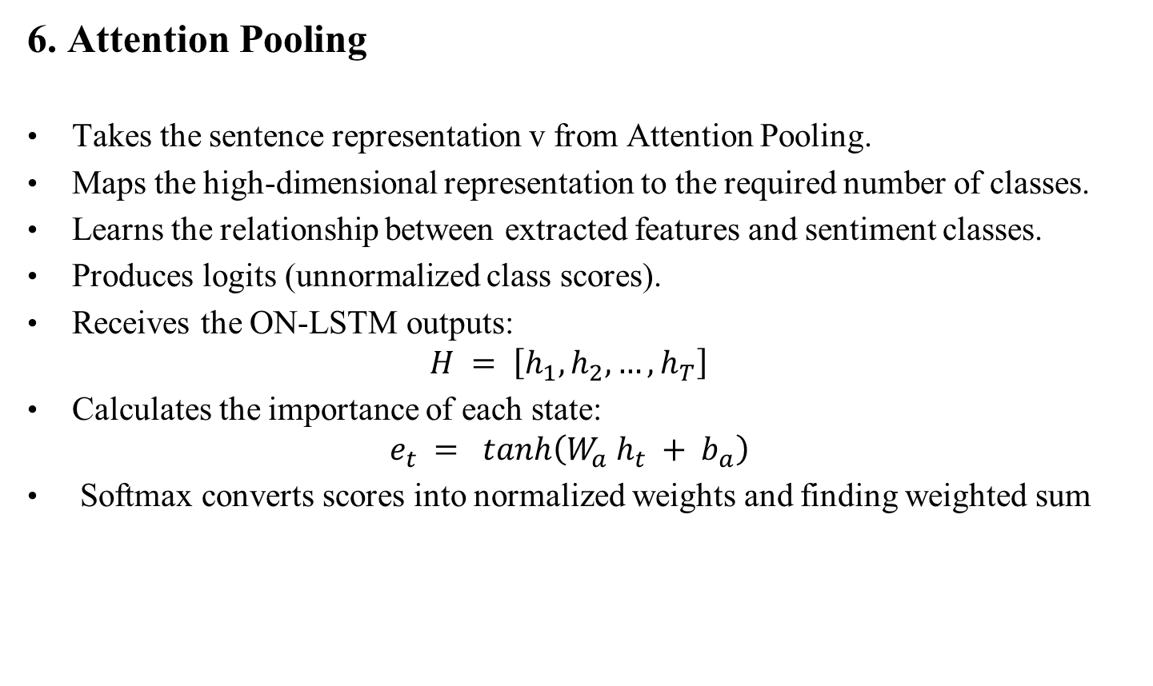
Description of Modules
6. Attention Pooling
Takes the sentence representation v from Attention Pooling.
Maps the high-dimensional representation to the required number of classes.
Learns the relationship between extracted features and sentiment classes.
Produces logits (unnormalized class scores).
Receives the ON-LSTM outputs:
$H = \left[h_{1}, h_{2}, …, h_{T}\right]$
Calculates the importance of each state:
$e_{t} = tanh\left(W_{a} h_{t} + b_{a}\right)$
Softmax converts scores into normalized weights and finding weighted sum

Slide 57
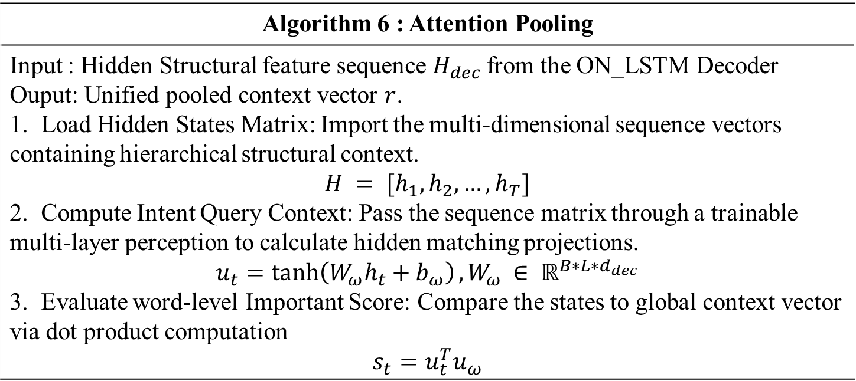
Description of Modules
Algorithm 6 : Attention Pooling
Input : Hidden Structural feature sequence $H_{dec}$from the ON_LSTM Decoder Ouput: Unified pooled context vector $r$. 1. Load Hidden States Matrix: Import the multi-dimensional sequence vectors containing hierarchical structural context. $$H = [h_{1}, h_{2}, …, h_{T}]$$ 2. Compute Intent Query Context: Pass the sequence matrix through a trainable multi-layer perception to calculate hidden matching projections. $u_{t}=\tanh\left(W_{ω}h_{t}+b_{ω}\right), W_{ω}$ $∈ ℝ^{B∗L∗d_{dec}}$ 3. Evaluate word-level Important Score: Compare the states to global context vector via dot product computation $$s_{t}=u_{t}^{T}u_{ω}$$

Slide 58
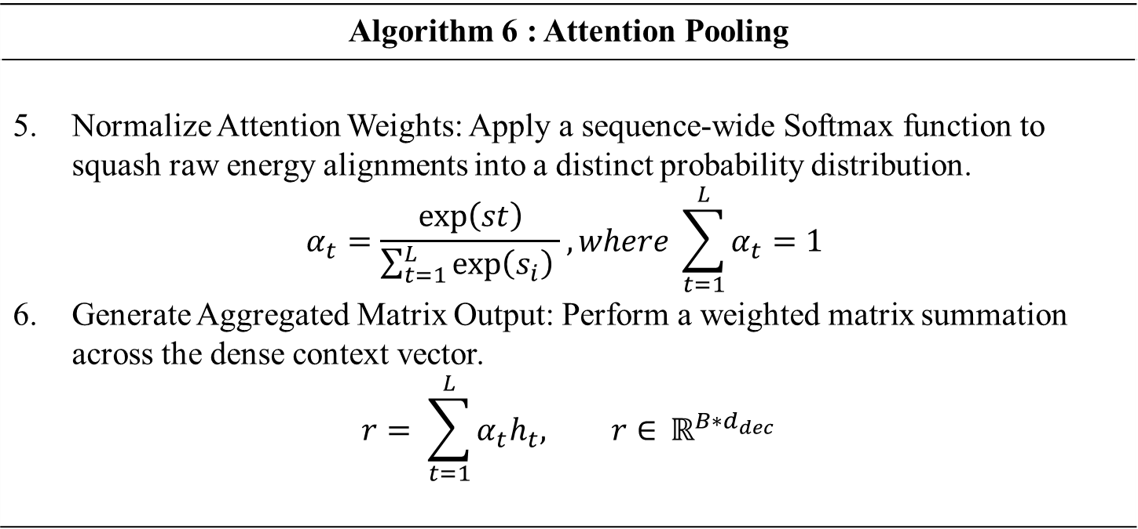
Description of Modules
Algorithm 6 : Attention Pooling
Normalize Attention Weights: Apply a sequence-wide Softmax function to squash raw energy alignments into a distinct probability distribution. $$α_{t}=\frac{\exp\left(st\right)}{\sum_{t=1}^{L}{\exp\left(s_{i}\right) }}, where \sum_{t=1}^{L}{α_{t}=1 }$$ Generate Aggregated Matrix Output: Perform a weighted matrix summation across the dense context vector. $$r= \sum_{t=1}^{L}{α_{t}h_{t}, r∈ }ℝ^{B∗d_{dec}}$$

Slide 59
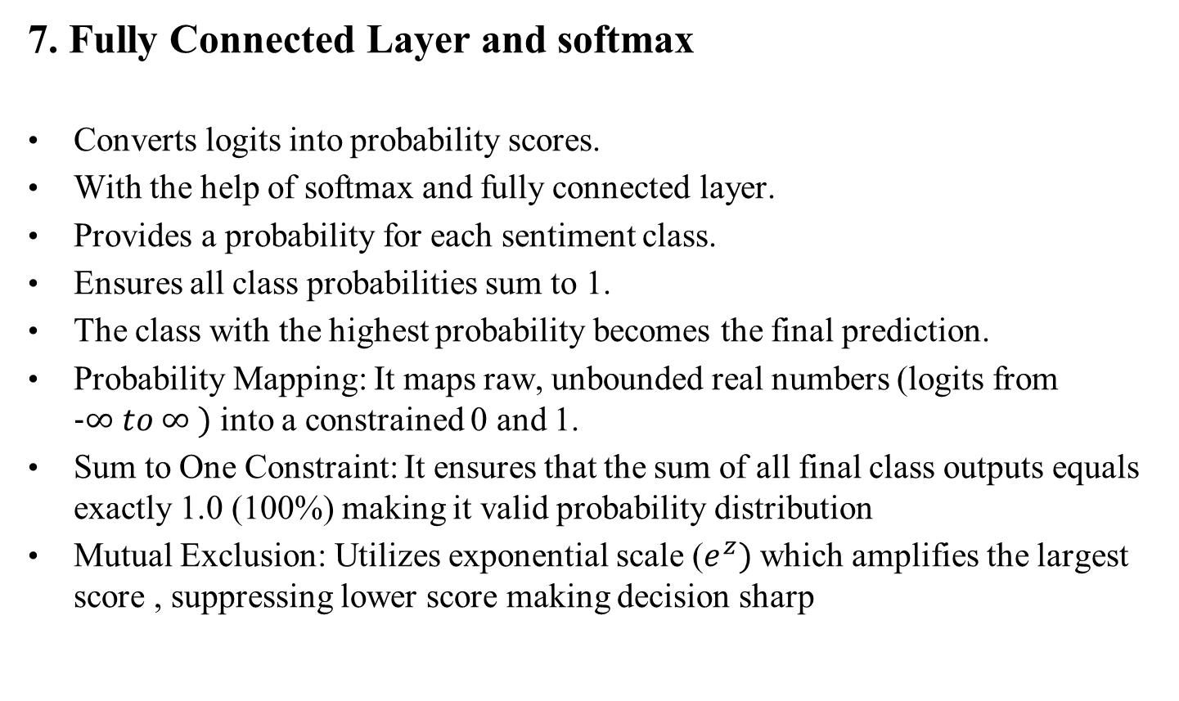
Description of Modules
7. Fully Connected Layer and softmax
Converts logits into probability scores.
With the help of softmax and fully connected layer.
Provides a probability for each sentiment class.
Ensures all class probabilities sum to 1.
The class with the highest probability becomes the final prediction.
Probability Mapping: It maps raw, unbounded real numbers (logits from $−∞ to ∞ )$ into a constrained 0 and 1.
Sum to One Constraint: It ensures that the sum of all final class outputs equals exactly 1.0 (100%) making it valid probability distribution
Mutual Exclusion: Utilizes exponential scale ($e^{z})$which amplifies the largest score , suppressing lower score making decision sharp

Slide 60
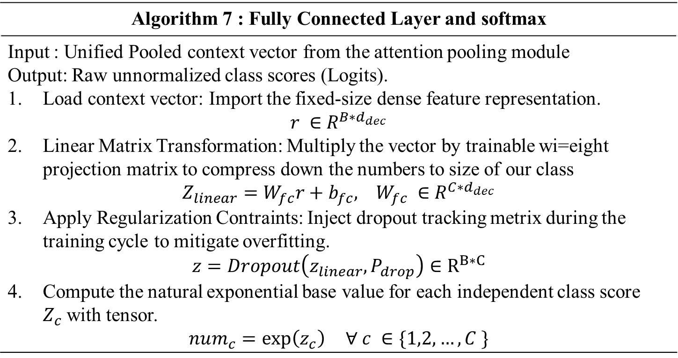
Description of Modules
Algorithm 7 : Fully Connected Layer and softmax
Input : Unified Pooled context vector from the attention pooling module Output: Raw unnormalized class scores (Logits). Load context vector: Import the fixed-size dense feature representation. $r ∈$ $R^{B∗d_{dec}}$ Linear Matrix Transformation: Multiply the vector by trainable wi=eight projection matrix to compress down the numbers to size of our class $Z_{linear}=W_{fc}r+b_{fc}, W_{fc} ∈$ $R^{C∗d_{dec}}$ Apply Regularization Contraints: Inject dropout tracking metrix during the training cycle to mitigate overfitting. $$z=Dropout\left(z_{linear},P_{drop}\right)∈R^{B∗C}$$ Compute the natural exponential base value for each independent class score $Z_{c}$with tensor. $$num_{c}=\exp\left(z_{c}\right) ∀ c ∈\{1,2, …, C \}$$

Slide 61
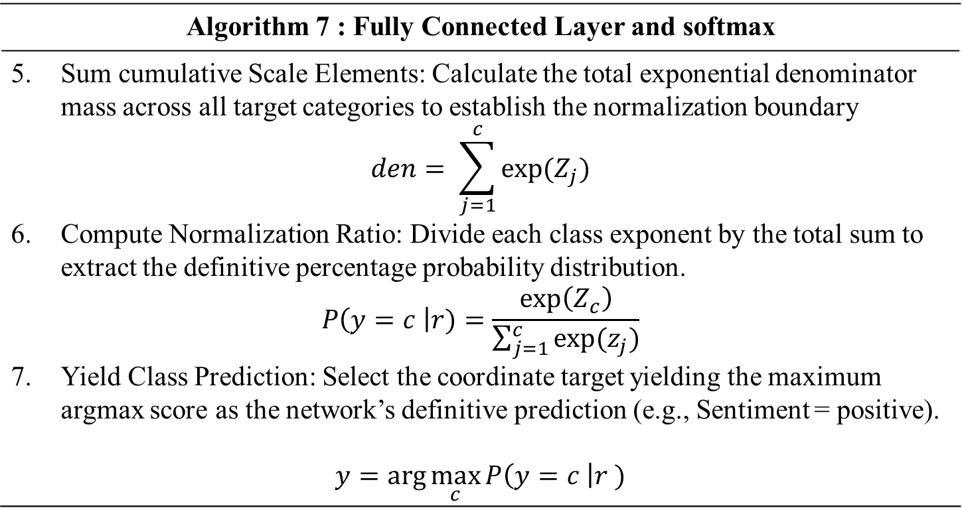
Description of Modules
Algorithm 7 : Fully Connected Layer and softmax
Sum cumulative Scale Elements: Calculate the total exponential denominator mass across all target categories to establish the normalization boundary $$den= \sum_{j=1}^{c}{exp⁡(Z_{j})}$$ Compute Normalization Ratio: Divide each class exponent by the total sum to extract the definitive percentage probability distribution. $$P\left(y=c \right|r)=\frac{\exp\left(Z_{c}\right)}{\sum_{j=1}^{c}{exp⁡(z_{j})}}$$ Yield Class Prediction: Select the coordinate target yielding the maximum argmax score as the network’s definitive prediction (e.g., Sentiment = positive). $$y=\arg{\max_{c}{P\left(y=c \right|r )}}$$

Slide 62
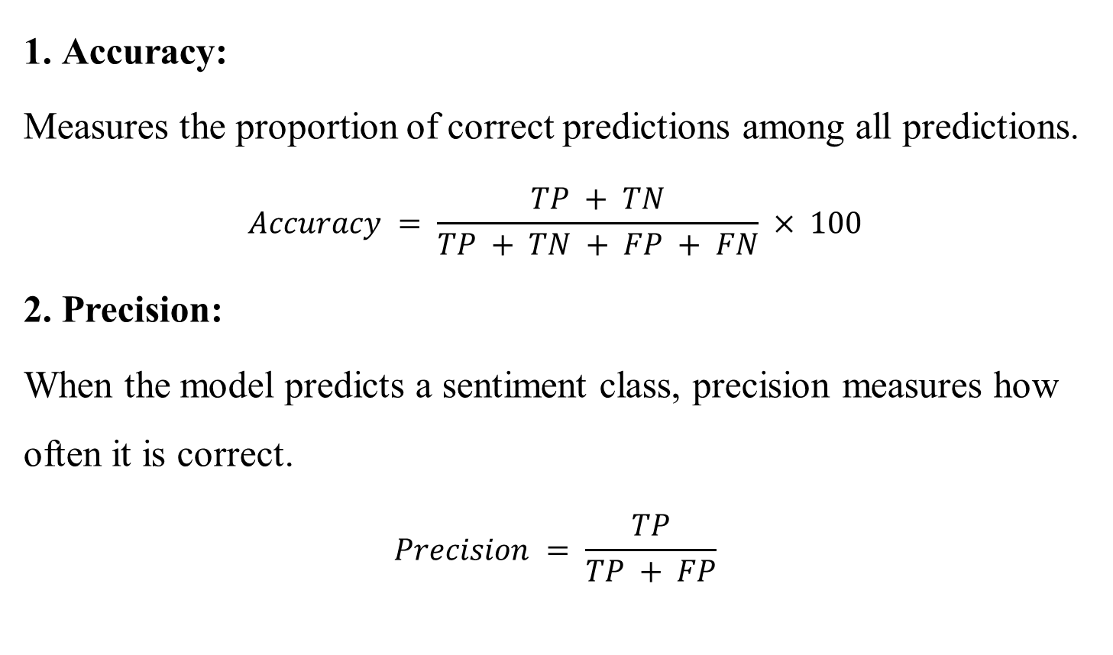
Evaluation Metrics
1. Accuracy:
Measures the proportion of correct predictions among all predictions.
$$Accuracy = \frac{TP + TN}{TP + TN + FP + FN} × 100$$
2. Precision:
When the model predicts a sentiment class, precision measures how often it is correct.
$$Precision = \frac{TP}{TP + FP}$$

Slide 63
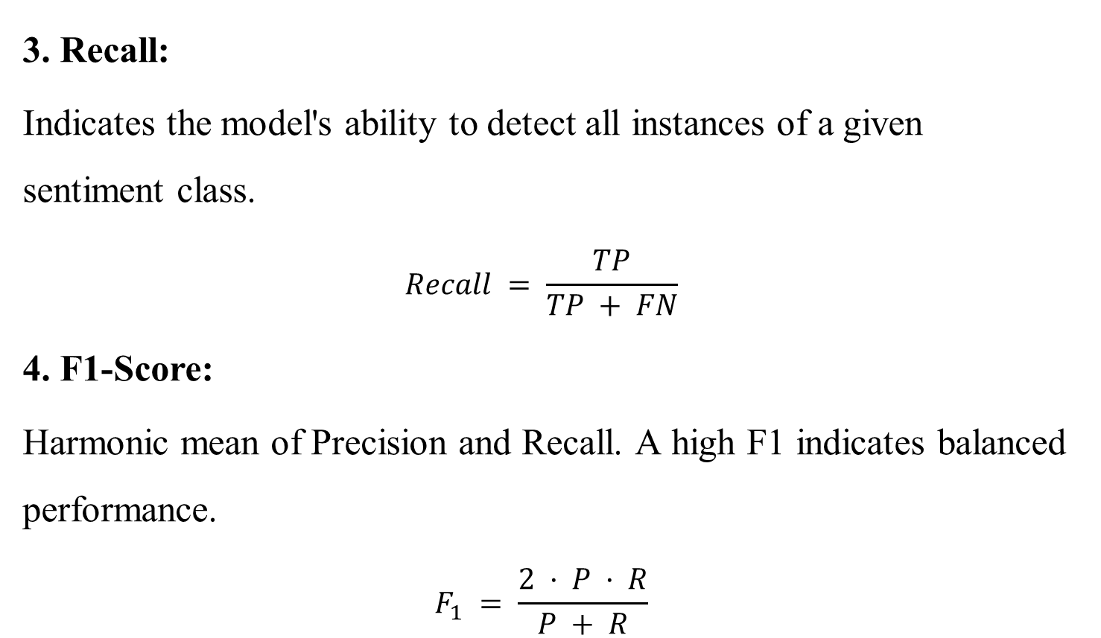
Evaluation Metrics
3. Recall:
Indicates the model's ability to detect all instances of a given sentiment class.
$$Recall = \frac{TP}{TP + FN}$$
4. F1-Score:
Harmonic mean of Precision and Recall. A high F1 indicates balanced performance.
$$F_{1} = \frac{2 · P · R}{P + R}$$

Slide 64
Working Environment
Programming Language
Python: 3.12.10
Pytorch: 2.7.1+cu118
Transformer 4.46.2
TensorFlow: 2.21.0
Deep Learning Libraries
Hugging Face Transformers
Pytorch / TensorFlow
Hardware
NVIDIA RTX 3050 GPU

Slide 65
Progress Details
Finished:
The Preprocessing and Tokenization Module
Training the Deberta Module for the entire IMDB dataset.
Yet To Finish:
Need to provide Adversarial Training to Transformer
Configure Optuna Hyper-paramerter optimizer to both the transformer and adversarial training
Implement the ON-LSTM Module, Attention Pooling, Fully Connected Layer and Softmax Module.

Slide 66
REFERENCES
Bo Yang et al., “TRALSem: A Robust Model for Textual Sentiment Analysis” IEEE Transactions on Computational Social Systems, vol. 12, no. 6, pp. 4727–4743, Dec. 2025. DOI: 10.1109/TCSS.2025.3558622
S. Hochreiter and J. Schmidhuber, “Long Short-Term Memory” Neural Computation, vol. 9, no. 8, pp. 1735–1780, 1997.
Y. Shen, S. Tan, A. Sordoni, and A. Courville, “Ordered Neurons: Integrating Tree Structures into Recurrent Neural Networks” in Proc. ICLR, 2019.

Slide 67
REFERENCES
Y. J. Devlin, M.-W. Chang, K. Lee, and K. Toutanova, “BERT: Pre-training of Deep Bidirectional Transformers for Language Understanding” in Proc. NAACL-HLT, Minneapolis, MN, USA, pp. 4171–4186, Jun. 2019.
P. He, X. Liu, J. Gao, and W. Chen, “DeBERTa: Decoding-enhanced BERT with Disentangled Attention” in Proc. ICLR, 2021.
I. Gupta and N. Joshi, “Feature-Based Twitter Sentiment Analysis With Improved Negation Handling” IEEE Transactions on Computational Social Systems, vol. 8, no. 4, 2021.

Slide 68
REFERENCES
I. J. Goodfellow, J. Shlens, and C. Szegedy, “Explaining and Harnessing Adversarial Examples” in Proc. ICLR, 2015.
C. Zhu et al., “FreeLB: Enhanced Adversarial Training for Natural Language Understanding” in Proc. ICLR, 2020.
J. Liu, W. Gao, M. Ou, B. Fu, X. Huang, and Y. Huan, “OnDeBERTa: An Ordered Neuron Memory Enhanced DeBERTa Model for E-commerce Review Sentiment Classification” in Proc. 2026 International Conference on Computer Intelligence and Software Engineering (CICSE), 2026.

Slide 69
REFERENCES
T. Akiba, S. Sano, T. Yanase, T. Ohta, and M. Koyama, “Optuna: A Next-generation Hyperparameter Optimization Framework” in Proc. 25th ACM SIGKDD International Conference on Knowledge Discovery & Data Mining, 2019.

Slide 70
THANK YOU

